Slide 1
NON - NARCOTIC
ANALGESIC DRUGS
MEDICINAL CHEMISTRY
By:Ararsa B
Email:ararsaboru20@gmail.com

Slide 2
Overviews
At end of this topice you should have to know
  Pharmacodynamic Effects these drug
    Mechanism of action of these drug
  Classification of this drug .
  SAR of each drug classification.
  Drugs for the treatment of Gout
  Approaches for the control of gout:

Slide 3
INTRODUCTION
NON NARCOTIC pain relievers commonly known as called NSAIDs
This drug act at local sit of injury to reduce inflammation
And also block (cox) an enzyme which Is used to synthesize prostaglandins which cause pain and inflammation
These are said to be cox inhibitors
1 cox-1 mediates gi tract and blood platelets
2 cox-2 mediates infiammation.

Slide 4
•Inflammation is series of changes that occur in living tissues following injury. Causes :
•physical agents like
•mechanical trauma,
•ultra-violet or ionizing radiation
•chemical agents like
•organic and inorganic compounds,
•the toxins of various bacteria,
•intracellular replication of viruses,
•hypersensitivity reactions
•necrosis of tissues whereby inflammation is induced in the surrounding tissues.

Slide 5
  Old drugs for the treatment of inflammation (steroids)
prednisolone,
Dexamethasone
betamethasone,
triamcinoline and
Hydrocortison
These drugs have several adverse effects and replaced by much safer and better tolerated non-steroidal anti-inflammatory drugs (NSAIDs).

Slide 6
Pharmacodynamic Effects NSAIDs
Analgesic (reduction of pain with sedation).
Antipyretic (reduction of body temp those with a fever).
Anti-inflammatory (except paracetamol) it is very low efficacy in the treatment of inflammation.
Two isozymes
COX-1 is the isoenzyme that is found to be active under normal healthy conditions.
COX-2, which is usually found to be quite dormant, gets duly activated and yields a substantial quantum of inflammatory prostaglandins .
COX-Selective 2 inhibitors are important drugs.

Slide 7
NSADs
  Mechanism of action of NSADs
depression of cyclooxygenases activity
decreasing of prostaglandins synthesis in peripheral tissues and in central nervous system
decreasing of sensitivity of nervous endings and depression of transmission of nociceptive impulses on the level of CNS structures
pain-relieving action of non-opioid analgesics is partly connected with their anti-inflammatory activity

Slide 8
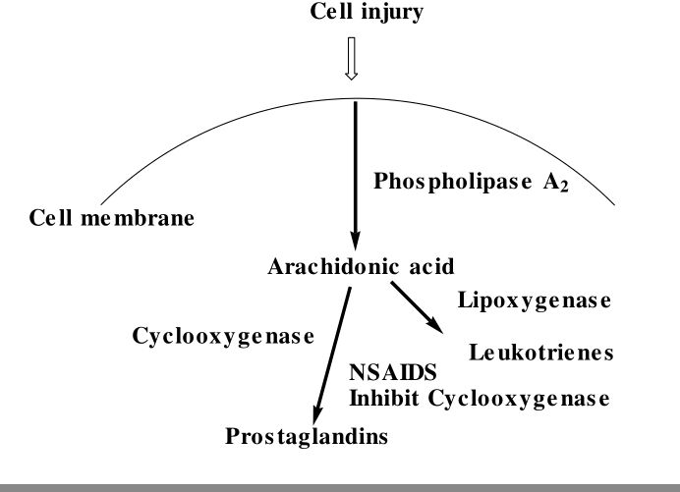
Con……
These drugs are of different chemical structures and are used for treatment of inflammatory and painful conditions

Slide 9
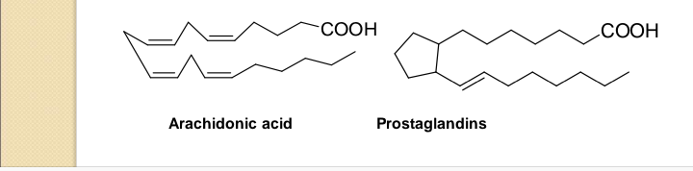
NSADs
Prostaglandins contribute to sign and symptoms of inflammatory processes including pain and edema.
Almost all classes of NSAIDs inhibit the conversion of arachidonic acid in to prostaglandins.

Slide 10
NSADs classfication
The non-steroidal ant-inflammatory drugs can be divided:
1. Saliclyates
2. pyrazolone and pyrazolidinediones derivatives
3. Arylacetic acids
4. Arylpropionic acids
5. Anthranilates
6. Arylsulfonamides

Slide 11
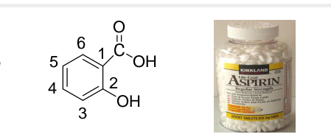
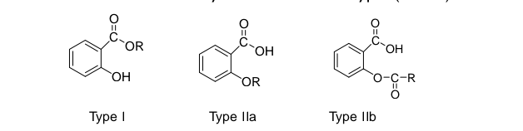
NSADs
1. Saliclyates
Are derivatives of salicylic acid and are two types ( (I and II)
Type I represents those that are formed by modifying the carboxyl group.
Type II (a and b) represents those that are substitution on the hydroxyl group of salicylic acid .
-The derivatives were introduced to prevent gastric symptom and undesirable tests of some common salt of salicylate

Slide 12
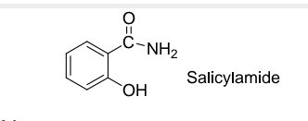
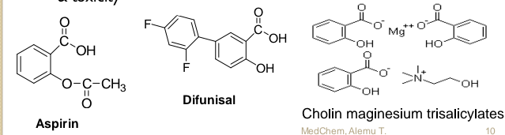
NSADs
Structure activity relationship
The active moiety appears to be the salicylate anion
Reduction of the acidity of the carboxylic group of the salicylate retain analgesic effect eliminating anti-inflammatory (Salicylamide)
Shift of phenolic OH group to meta or Para to carboxyl abolish activity
Hydrophobic substituent at 5 position of salicylic acid improved activity
Halogen atom substitution on the aromatic ring enhances potency & toxicity.

Slide 13
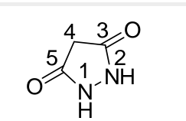
NSADs
2. 3, 5-pyrazolidinediones
Phenylbutazone is a non steroidal anti-inflammatory drug (NSAID) for the short-term treatment of pain and fever in animals.
In the United States and United Kingdom, it is no longer approved for human use, as it can cause severe adverse effects such as suppression of white blood cell production and aplastic anemia

Slide 14
Con……
Structure activity relationship
Hydrogen atom at C4 is acidic & this is enhanced by the two-ketone groups.
Decreasing /eliminating acidity abolishes activity.
If acidity increases too much uricosuric activity increases while ant inflammatory decreases.
Single alkyl substituent at C4 enhances antiinflammatory activity n-butyl is the most active the presence of two phenyl groups in the ring nitrogen is not important for anti-inflammatory & analgesic activity.
Pyrrole and isoxazole analogue of phenylbutazone retain activity.

Slide 15
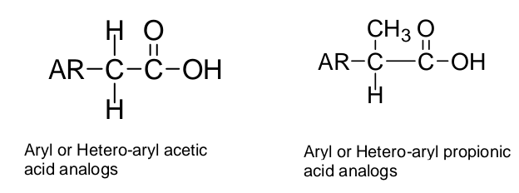
Con……
3. Arylalkanoic acids

Slide 16
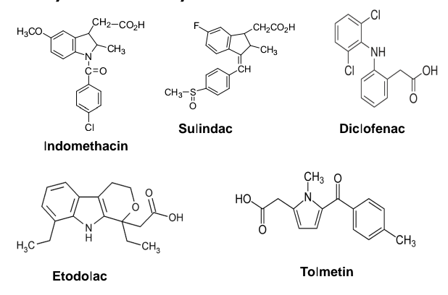
Cont…
Aryl and heteroarylacetic acids

Slide 17
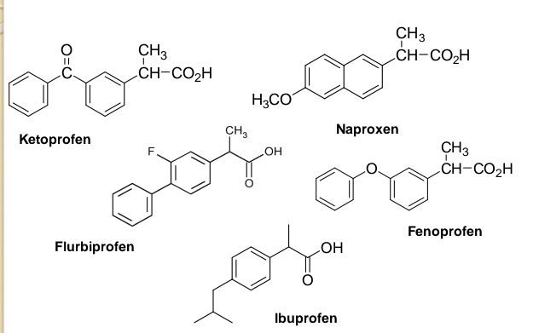
Cont..
Aryl and heteroarylpropionic acid derivatives

Slide 18
SAR
All agents have an acidic and aromatic center.
Derivatives of aryl or heteroaryl acetic/propionic acid correlates with carboxylic acid and double at position C5 and C8 of arachidonic acid.
The activity of ester & amide derivative carboxylic acid is due to its metabolic hydrolysis.
The center of acidity is located one carbon atom from the aromatic ring .
◦ This distance is critical.
◦ Increase distance to two or three carbons generally diminishes activity.
Methyl substitution on the carbon atoms separating the acid and aromatic group increases antiinflammatory activity and reduces side effects .
Groups more than methyl decrease antiinflammatory activity.

Slide 19
cont…
N-benzoyl derivatives substituted in the Para-position with fluoro, chloro, trifluoromethyl, or thiomethyl group are the most active.
The 5 –position of the indole ring is most flexible with regard to the nature of substituent,which enhances activity.
◦Substituents such as methoxy, fluoro, dimethylamino, methyl, allyloxy, and acetyl are more active than unsubstituted indole ring.
The presence of an indole nitrogen is not essential for activity because the corresponding 1-benzylidenylindene analogs (e.g., sulindac) are active
◦ Sulindac is biososter of indomethacin

Slide 20
4. Arylanthranilic acids
◦ The anthranilic derivatives are nitrogen isosters of salicylic acid
◦ Are the results of the application of bioisosteric drug design

Slide 21
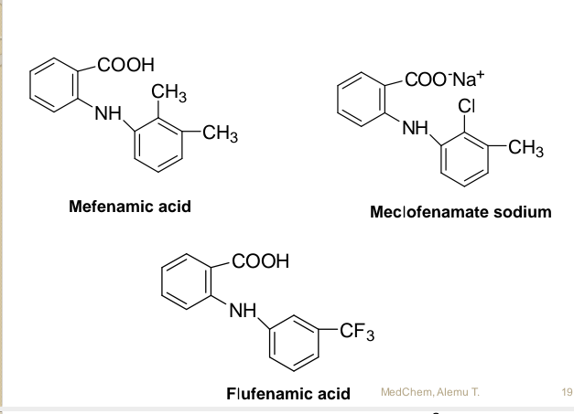
Cont….

Slide 22
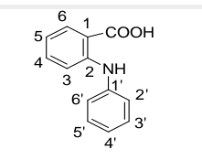
SAR
Substitution on the anthranilic acid ring generally reduces activity while substitution of the N-aryl ring can lead to conflicting results.
The most active once have a small alkyl or halogen substituent at 2’, 3’ and/or 6’ position of the N-aryl moiety.
Among disubstituted N-arylfenamates 2’ and 3’ derivatives are most active
These substituents serve to force the N-aryl ring out of co planarity with anthranilic acid

Slide 23
CONT….
NH moiety is essential for activity
Replacement of NH with O, CH2, S, SO2, NCH3 or NCOCH3 significantly reduces activity
The position rather than the nature of the acidic function is critical for activity
Replacement of carboxylic acid function with
isossteric tetrazole moiety has little effect on activity

Slide 24
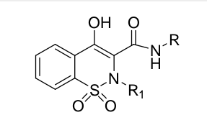
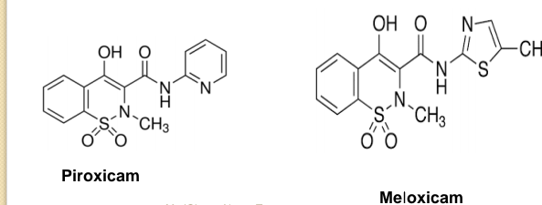
5.Arylsulfonamides (Oxicams)
The oxicams are a group of non-steroidal anti-inflammatory agents containing 2-benzothiazine,3-carboxamide, 1,1-dioxide moiety as common structure entity.

Slide 25
SAR
Within the series of 4-hydroxyl-2-benzothiazine carboxamides
Optimal activity is observed when R1 is methyl substituent
R (Carboxamides substituent) is generally an Aryl/ heteroaryl substituent because alkyl substituent are less active
N-hetrocyclic carboxamides are more acidic than the corresponding aryl carbamate
In the aryl series meta-substituted derivatives are generally more potent than p-isomers
In the aryl series maximum activity is observed with a meta-Cl substituent

Slide 26
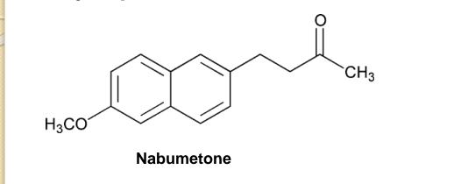
6. Naphthylalkanone
Nabumetone is a non-steroidal anti-inflammatory drug (NSAID), the only 1-naphthaleneacetic acid derivative
Nabumetone has been developed by Beecham
It is available under numerous brand names, such as Relafen, Relifex, and Gambaran

Slide 27
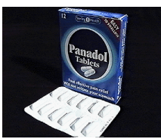
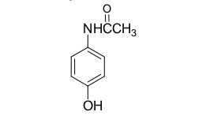
CONT….
Para- aminophenol derivatives
are para aminophenol derivatives
They possess analgesic and antipyretic but not antiinflammatory activite
Paracetamol (N-Acetyl-p-Aminophenol) is a prototype
It was found based on the discovery that aniline and acetanilide have powerful antipyretic property

Slide 28
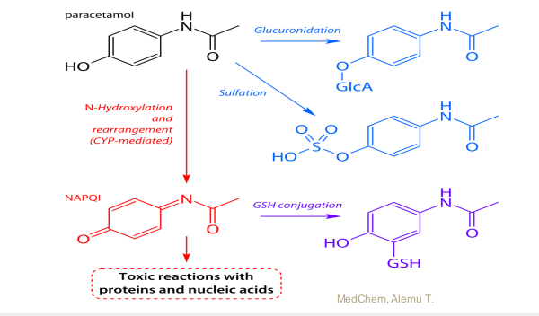
CONT…
Paracetamol overdose causes sever hepatotoxicity with necrosis and liver failure by forming N-acetyl-pbenzoquinone imine (NAPQI)
◦ Due to the formation of hepatotoxic metabolite

Slide 29
COX2 Inhibitors
The COX-2 form of the enzyme is highly inducible by a number of pro-inflammatory mediators, and appears to be responsible for the high level of prostaglandin synthesis that results in inflammation.
Thus, a specific inhibitor of COX-2 could prove to be effective against inflammation, but would allow COX-1 to perform its normal physiological functions, including gastroprotection.
Interestingly, some of the newer NSAIDs, notably nabumetone and etodolac, show a high ratio of COX-2 to COX-1 activity.
However , there is an ongoing search for COX-2-specific inhibitors

Slide 30
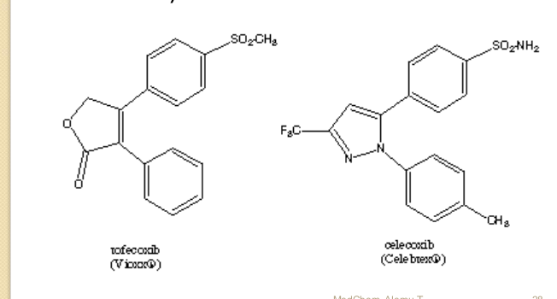
Con……
Two such COX-2 inhibitors, celecoxib and rofecoxib have recently been marketed

Slide 31
Drugs for the treatment of Gout
Gout is an inflammatory disease characterized by elevated level of uric acid (as urate ion) in the plasma and urine and may take both acute and chronic forms.
Acute gouty arthritis results from the accumulation of needle like crystals of monosodium urate monohydrate with in the joints, synovial fluid and periarticular tissue, and usually appears without warning signs.
The increase in extra cellular urate may be caused by:
Increased uric acid biosynthesis
Decreased urinary excretion of uric acid
A combination of both

Slide 32
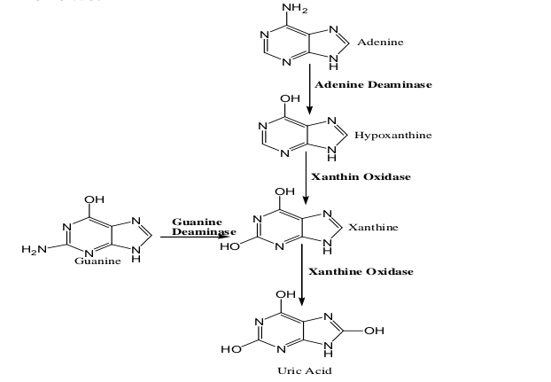
CONT…
Uric acid is formed from adenine and guanine as follows:

Slide 33
Uric acid is a weak acid with very low water solubility. At physiological PH it exists primarily as the monosodium salt, which is somewhat more soluble in aqueous medium.
At super saturation the sodium urate precipitates to form urate crystals. These urate crystals initiate attacks of gouty arthritis.
Approaches for the control of gout:
Control of acute attacks by drugs to reduce inflammation caused by the deposition of the crystals (these drugs may possess only anti-inflammatory activity). Eg. Colchicines, Indomethacine, Phenylbutazone, Naproxen
Increasing the rate of uric acid excretion (Using uricosuric agents)
Inhibiting the biosynthesis of uric acid by inhibiting the enzyme xanthine oxidase with drugs such as Allopurinol.

Slide 34
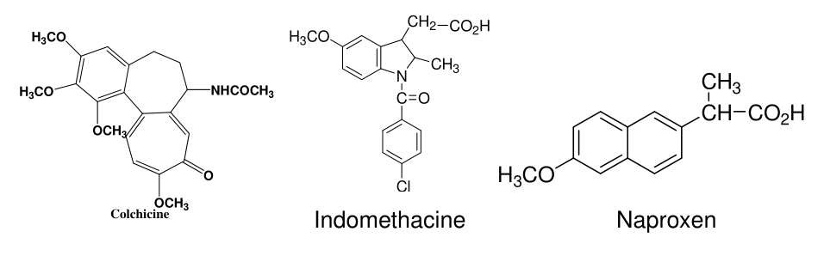
Cont…
1. Controling acute attacks by using drugs

Slide 35
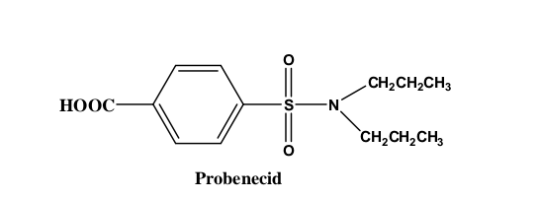
Cont…
2. Uricosuric Agents
Probenecide (Benemid)
Is a highly lipid soluble benzoic acid derivative.
It enhances the excretion of uric acid by preventing its reabsorption in the kidneys.

Slide 36
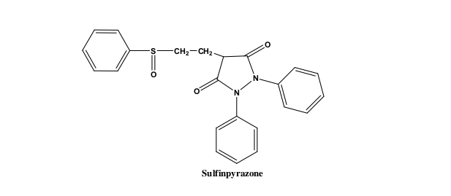
Cont…
b. Sulfinpyrazone (Aturane)
It produces its uricosuric effect in a manner similar to that of probenecid.
• Unlike other pyrazolidinediones, sulfinpyrazone has no analgesic and anti-inflammatory activities.

Slide 37
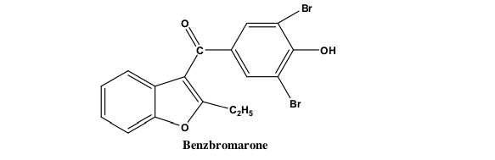
Cont….
c. Benzbromarone
is a potent and reversible inhibitor of the urate anion exchanger in the proximal tubule.
is metabolized to the monobromine and dehalogenated derivatives, both of which have uricosuric activity, and is excreted primarily in the bile.

Slide 38
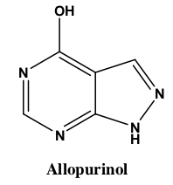
Cont…
3. Enzyme inhibitors
Allopurinol
Due to structural similarity b/n allopurinol and hypoxanthine, it inhibits the enzyme xanthine oxidase which is responsible for production of uric acid

Slide 39
THANK YOUUUUU

